Slide 1
Impactful Storytelling: Craft a Business Value and Human Value Story to Increase Influence

Slide 2
by
MARYAM GOLABGIR
With customers bombarded by advertisements and marketing messages, companies must find ways to connect on a deeper level.
Maryam Golabgir, our CEO, will be leading the team. She’s a digital marketer, programmer, and website guru. Maryam believes creating a sustainable digital marketing strategy will require a sharp vision and many metrics to accompany digital plans. Maryam’s digital expertise includes social media marketing strategies, website development, search engine marketing and optimization, online advertising, and video / mobile marketing. Digital Marketing Experts was nominated as one of the top advertising agencies in the York Region last year.
For more information about our business, you can visit www.digitalmarketingexperts.ca or my LinkedIn profile https://www.linkedin.com/in/maryamgolabgir

Slide 3
Storytelling has been a fundamental part of human culture for thousands of years.

Slide 4
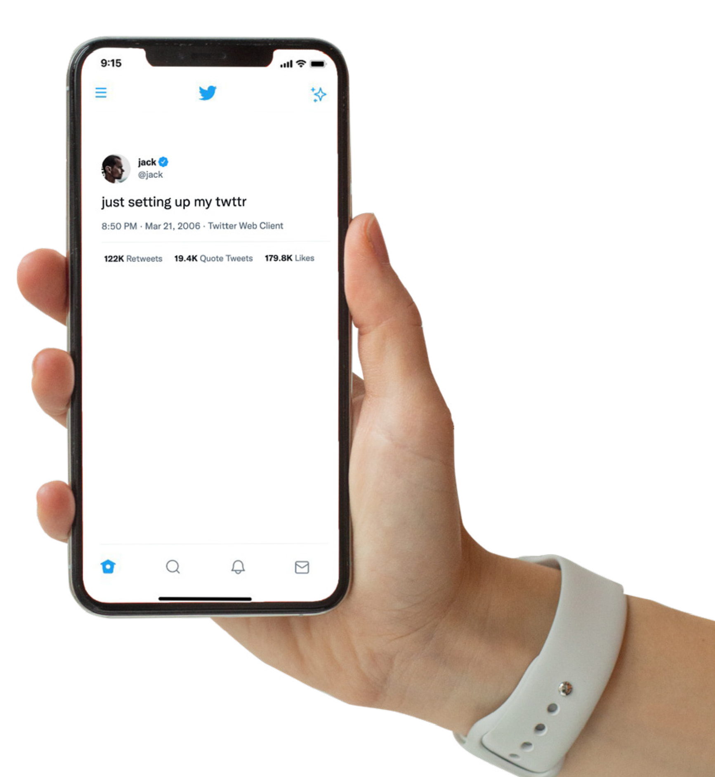
Storytelling has been a fundamental part of human culture for thousands of years. It is a powerful way to communicate ideas, values, and emotions.

Slide 5
1
The Power of Storytelling
storytelling allows companies to:
Connect Emotionally: Stories engage emotions, making messages more memorable and impactful.
Build Trust: Authentic stories build credibility and trust with your audience.
Differentiate Your Brand: Unique stories set your business apart from competitors.
Simplify Complex Concepts: Stories make complex ideas more understandable and relatable.

Slide 6
Why Small Businesses Should Focus on Storytelling
For small businesses, storytelling is not just a marketing tactic; it's a vital strategy to build a loyal customer base and grow sustainably.
Limited Marketing Budgets Storytelling is a cost-effective way to make a significant impact.
Personal Connections: Small businesses can leverage their individual stories and community ties to create strong connections with their audience.
Humanizing the Brand: Storytelling helps humanize the brand, making it more relatable and approachable.
Enhanced Online Presence: Compelling stories can increase engagement on social media, blogs, and other online platforms, driving more traffic and leads.

Slide 7
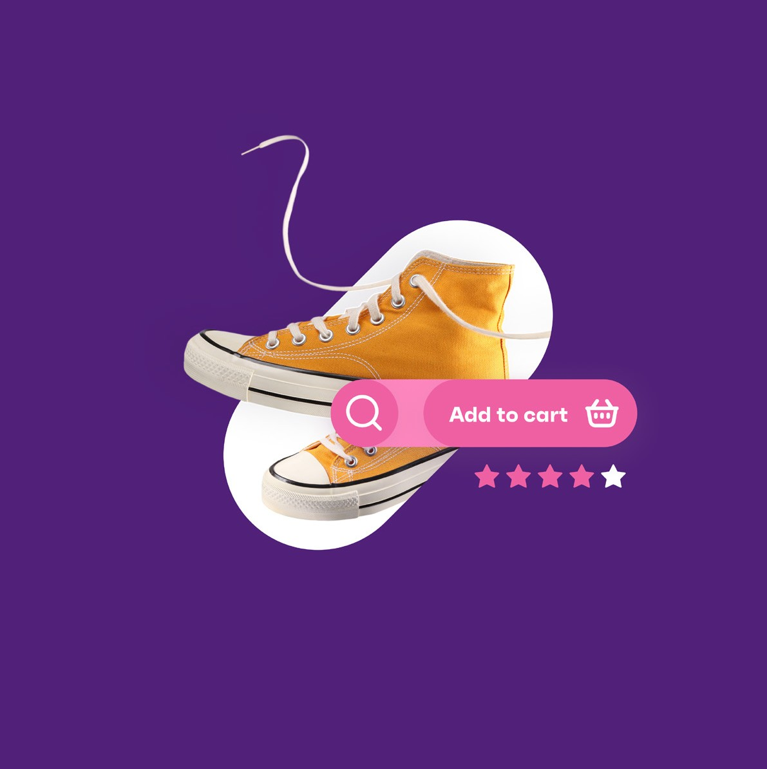
Crafting a Business Value Story

Slide 8
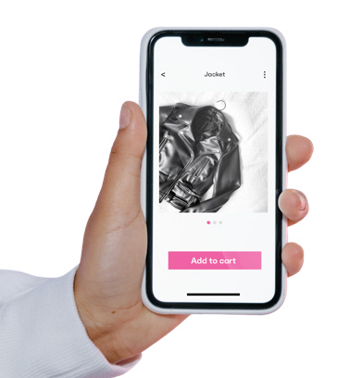
Canva: A graphic design tool that helps create visually appealing content, such as social media posts, infographics, and presentations.
Adobe Spark: A tool for creating engaging visual stories with videos, web pages, and social graphics.
Animoto: A video creation tool that allows you to produce professional-quality videos for storytelling quickly.
Hootsuite: A social media management tool that helps schedule and analyze your storytelling content across multiple platforms.
HubSpot: A comprehensive marketing platform that includes tools for content creation, social media management, and analytics.
Google Analytics: An essential tool for tracking the performance of your storytelling efforts and understanding audience behaviour.
Tools for Storytelling

Slide 9
Crafting a Business Value Story
A business value story highlights the unique value propositions of your products or services. It explains why customers should choose your business over competitors.
Identify Your Unique Selling Proposition (USP)
Understand Your Audience
Structure Your Story
Use Data and Evidence

Slide 10
Crafting a Human Value Story
A human value story focuses on your business's emotional and social impact. It highlights your values, mission, and the positive change you bring to your community or customers' lives.
Define Your Core Values
Highlight Real Stories
Showcase Authenticity
Incorporate Visuals

Slide 11
Steps to Implement Storytelling in Your Business
Define Your Brand Story: Outline the core narrative of your brand, including your mission, values, and unique aspects.
Identify Key Storytelling Opportunities: Determine where you can incorporate storytelling in your marketing strategy, such as on your website, social media, email campaigns, and advertisements.
Create a Content Calendar: Plan your storytelling content to ensure consistency and alignment with your marketing goals.
Engage Your Audience: Encourage your audience to share their stories and experiences with your brand. User-generated content can add authenticity and build trust.
Analyze and Adjust: Regularly review the performance of your storytelling efforts using analytics tools. Adjust your strategy based on what resonates best with your audience.

Slide 12
Understanding AI-Driven Storytelling
1. Analyzing Audience Insights
AI-driven storytelling involves using AI technologies to craft, distribute, and optimize narratives that resonate with audiences. AI can assist in various aspects of storytelling, from generating content ideas to analyzing audience responses. .
2. Generating Content Ideas
3. Crafting Personalized Narratives
4. Automating Content Creation
5. Optimizing Distribution

Slide 13
Analyzing Audience Insights
Generating Content Ideas
Crafting Personalized Narratives
Automating Content Creation
Optimizing Distribution

Slide 14
Case Study 1: Business Value Story
Company: GreenTech Solutions
Challenge: GreenTech Solutions, a small startup specializing in eco-friendly technology, needed to differentiate itself in a competitive market.
Solution: GreenTech crafted a business value story highlighting their unique selling proposition: innovative, sustainable products that reduce energy consumption and lower business costs.
Execution: They created a series of blog posts, social media content, and a video series showcasing their products' benefits, supported by customer testimonials and case studies.
Results: The storytelling campaign increased website traffic by 35%, social media engagement by 50%, and generated a 20% increase in leads.
Case Studies

Slide 15
Case Study 2: Human Value Story
Company: Hope Bakery
Challenge: Hope Bakery, a small family-owned bakery, wanted to strengthen its community presence and attract more customers.
Solution: Hope Bakery crafted a human value story focusing on its mission to provide job opportunities to local youth and support community events.
Execution: They shared stories of their employees' personal growth, customer experiences, and involvement in local charity events through social media, newsletters, and their website.
Results: The campaign fostered a strong sense of community, leading to a 25% increase in local customers and a 15% rise in online orders.
Case
Studies

Slide 16
Do you have any questions?

