Slide 1
Shopify Website Marketing Tools to grow online sales

Slide 2
by
MARYAM GOLABGIR
I have 18 years of digital marketing expertise in Telecommunication, E-Commerce, IPTV, A.I. Development, Broadband, renewable energy and Financial industries.
After spending ten years leading marketing teams for various fortune 500 companies, I decided to start Digital Marketing Experts. This marketing agency caters to small to medium size businesses in the Ontario, Calgary, and Vancouver. As a female entrepreneur, I have gained a unique perspective on the lives of female business owners. I understand the struggle and have learned how to design, execute and measure marketing strategies and customized campaigns for each business.
I believe it is essential to create a sustainable digital marketing strategy which will require a sharp vision and many metrics to accompany digital plans. Our digital expertise is in Social Media Marketing strategies, Website Development, Search Engine Marketing and Optimization, Online Advertising and Video / Mobile Marketing. For more information about our business, you can visit www.digitalmarketingexperts.ca or my LinkedIn profile https://www.linkedin.com/in/maryamgolabgir
The world of ecommerce is booming, and it shows no signs of slowing down. In fact, experts predict that by 2023, the e-commerce market will reach a staggering $1.8 trillion in sales.

Slide 3
Top Ecommerce Marketing Tools for 2024
Notes:
Traditionally, marketing focuses on top-of-funnel activities that attract potential customers and deliver them to sales teams. Growth marketing integrates the entire pipeline. When implemented effectively, this approach leverages every opportunity to acquire, convert, and retain the most customers in the shortest period — ultimately driving rapid growth.
Growth marketing often re-envisions the role of marketing departments to achieve these goals. Rather than generating leads, growth marketers create a qualified pipeline that makes revenue the overarching goal. This approach aligns teams with sales departments philosophically and often contributes to cost reduction across the entire pipeline.
Top-of-funnel marketing may be enough if your marketing and sales teams are already aligned. However, if KPIs don’t translate into sales or decrease churn, growth marketing is an excellent solution.
It’s particularly effective among B2B companies in the tech sector, where a holistic approach to performance drives revenue. Forthcoming research from 6sense shows that the best B2B marketers are:
28% more likely to list revenue as their top KPI
17& more likely to take responsibility for upsells
21% more likely to take responsibility for customer retention

Slide 4
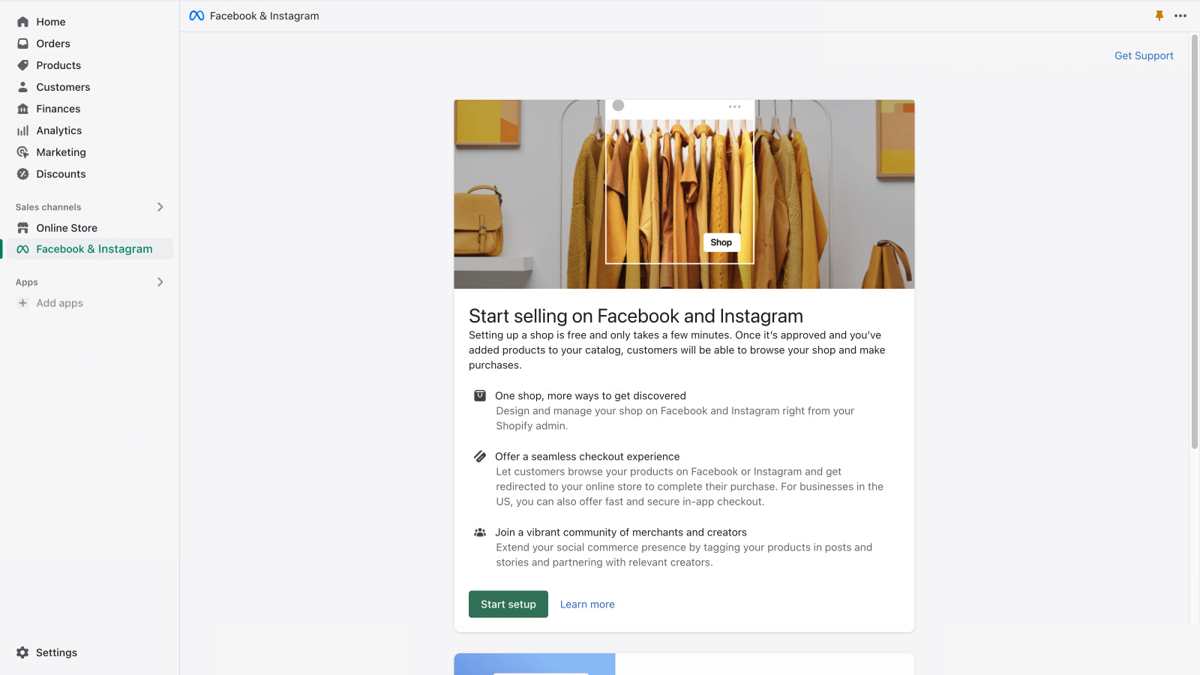
Facebook & Instagram
Sell on Facebook and Instagram and seamlessly manage your business from one place in Shopify. This Tool has a free version. Reach new customers and offer a seamless in-app shopping experience, from discovery to checkout.
Automatically sync your eligible products to your Facebook and Instagram shop, so you can sell from one inventory while easily creating ads and shoppable posts right where your customers are.

Slide 5
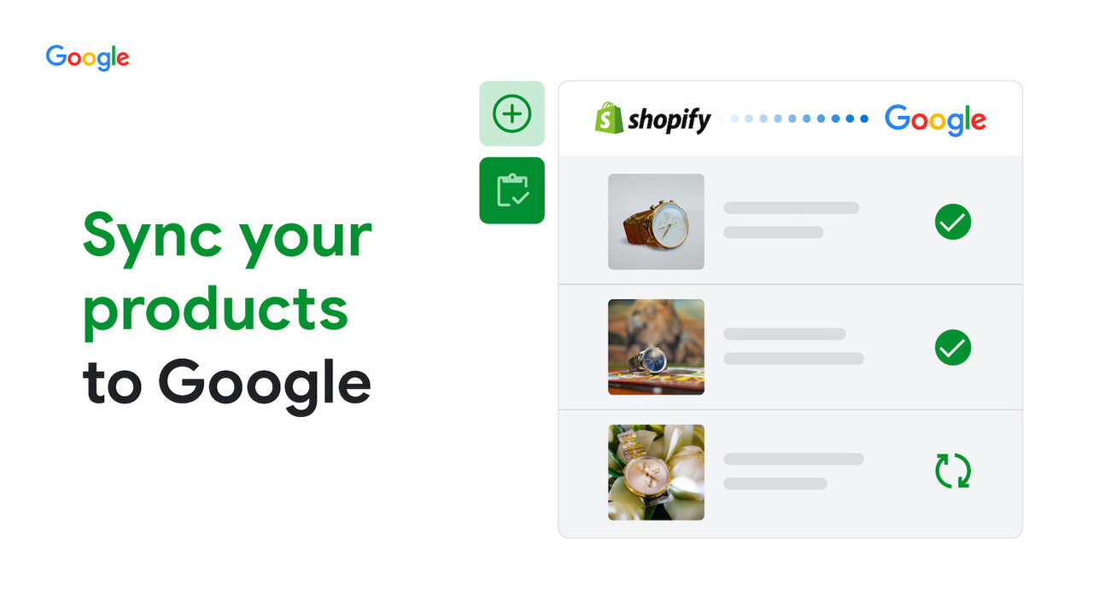
Google Shopify App
Sync your products, deals, and shipping to Google Merchant Center to turn more shoppers into customers. Help drive more sales with Performance Max ads across properties like Search, YouTube and Display and unlock ecommerce insights with Google Analytics.
Connect your store to Merchant Center to show your products across Google
Help drive more sales with a Performance Max ad campaign, powered by Google AI
Connect your store to YouTube so viewers can shop your videos & show support
Connect the full ecommerce journey with insights in Google Analytics
Sync product details from Shopify to show deals, shipping and returns on Google

Slide 6
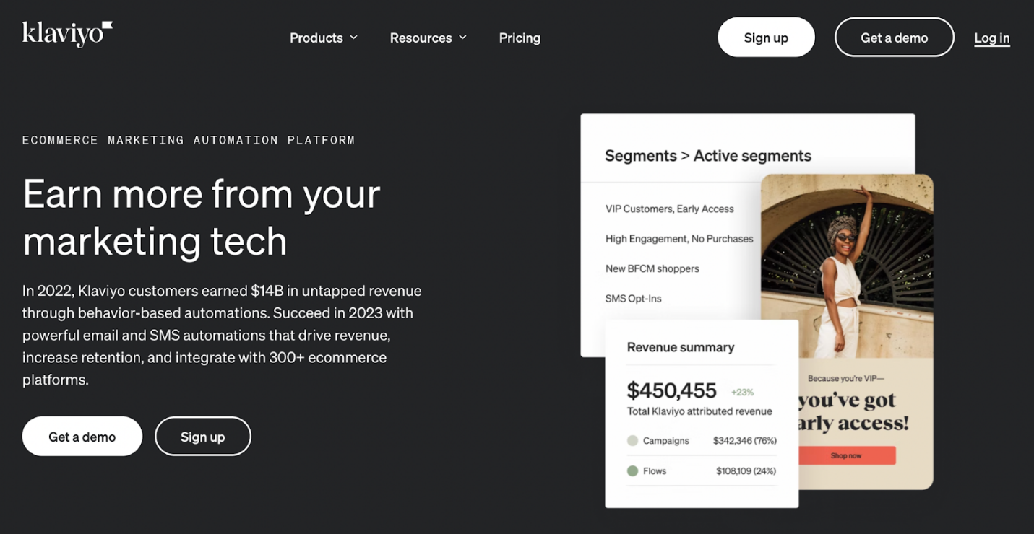
Klaviyo
Klaviyo is an email and SMS marketing tool for eCommerce businesses that helps you deliver personalized experiences.
Klaviyo includes pre-built email flows with defined triggers and timelines for the most popular campaigns like abandoned cart reminders, post-purchase thank you messages, product reviews, and welcome series for new subscribers.
Use cases: Send highly personalized emails, track your ROI, and build customer loyalty
Type of platform: Standalone SaaS and Klaviyo Shopify app
Free trial: No, but a free plan is available with all the basic features
Starting price: $20/month

Slide 7
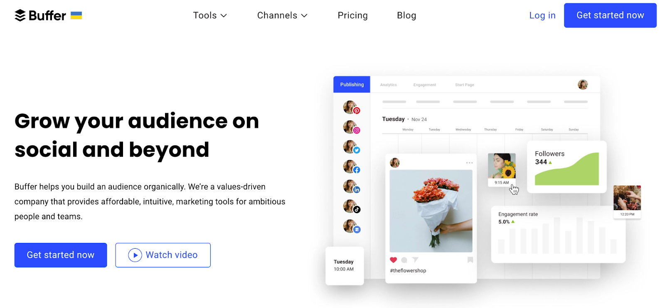
Buffer
Buffer is a social media management tool that allows you to schedule posts on all major platforms.
You can auto-publish your posts, carousels, and reels directly to Instagram and include a first comment when you schedule posts. For TikTok, you can plan and set reminders for your Stories and videos and receive a mobile notification when it's time to share.
Use cases: Schedule, publish, and analyze your social media posts
Type of platform: Standalone SaaS
Free trial: No, but a free plan is available
Starting price: $5/month

Slide 8
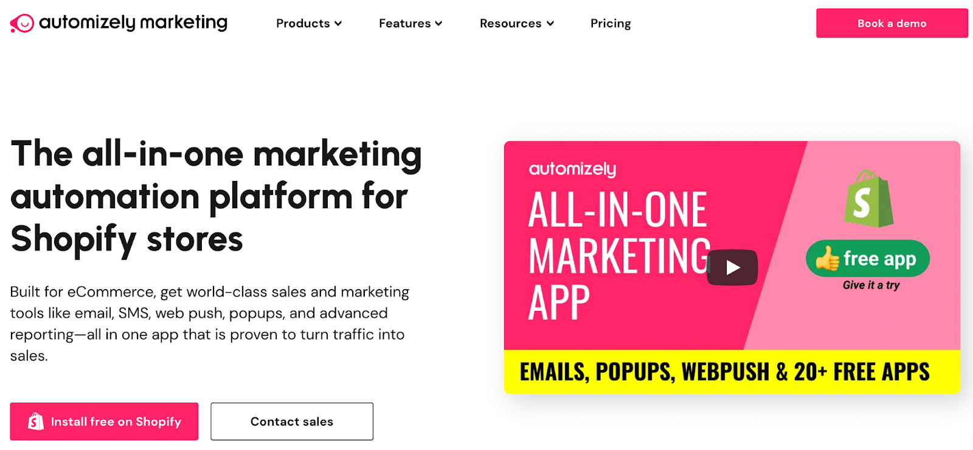
Automizely
Automizely is a comprehensive marketing platform for eCommerce businesses. As a Shopify app, it's built to help your store perform better, increase ROI, and drive brand loyalty.
Let's have a look at some of the features Automizely provides:
Automated flows: Send emails based on customer behavior and increase sales
Popups: Launch scenario-based popups like spin the wheel and collect leads
SMS: Send personalized text messages to welcome new subscribers, inform them of a sale, or recover abandoned cart
Use cases: Market your eCommerce store through email, SMS, and popups
Type of platform: Shopify app
Free trial: Yes
Starting price: $11/month

Slide 9
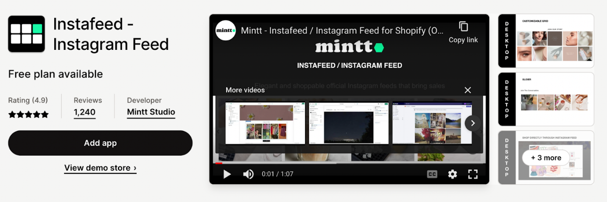
Instafeed
Instafeed is a Shopify app that lets you integrate your Instagram feed directly into your store.
Most small businesses start from Instagram, and it's highly likely that your brand has already posted a lot of high-quality content on the platform. So, it makes sense to use this content on your store to build social proof, convert your store visitors into customers and increase your Instagram followers.
Use cases: Display custom shoppable Instagram Feeds on your store
Type of platform: Shopify app
Free trial: Yes
Starting price: $5.99/month

Slide 10
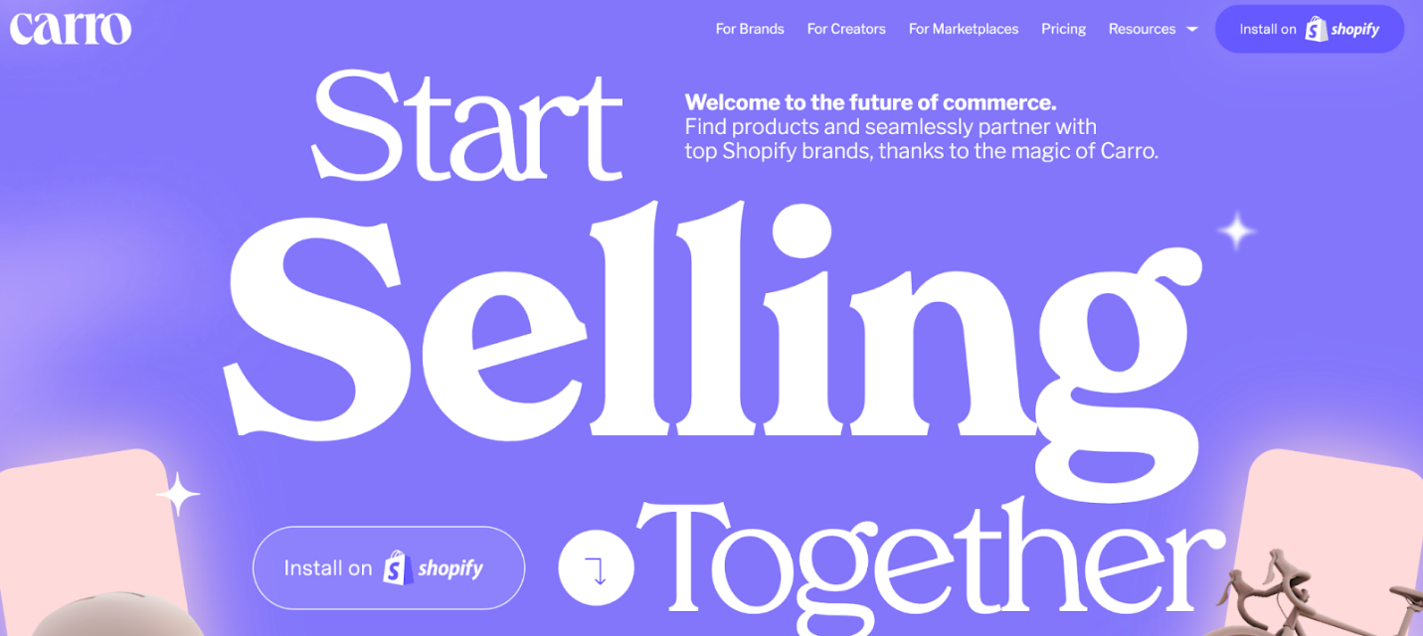
Carro
Carro is a cross-store selling and influencer collaboration platform. You can join Carro as an online retailer, product supplier, or both.
If you're a creator, you can transform your fanbase into a business by selling products from top Shopify brands on Carro. With Carro's "Virtual Inventory," you can sell products from top Shopify brands but don't have to purchase inventory or be responsible for fulfilling your fan's orders — all you have to do is pick the products and create content.
Use cases: Sell products through cross-store selling and collaborating with influencers
Type of platform: Shopify app
Free trial: Yes
Starting price: $50/month

Slide 11
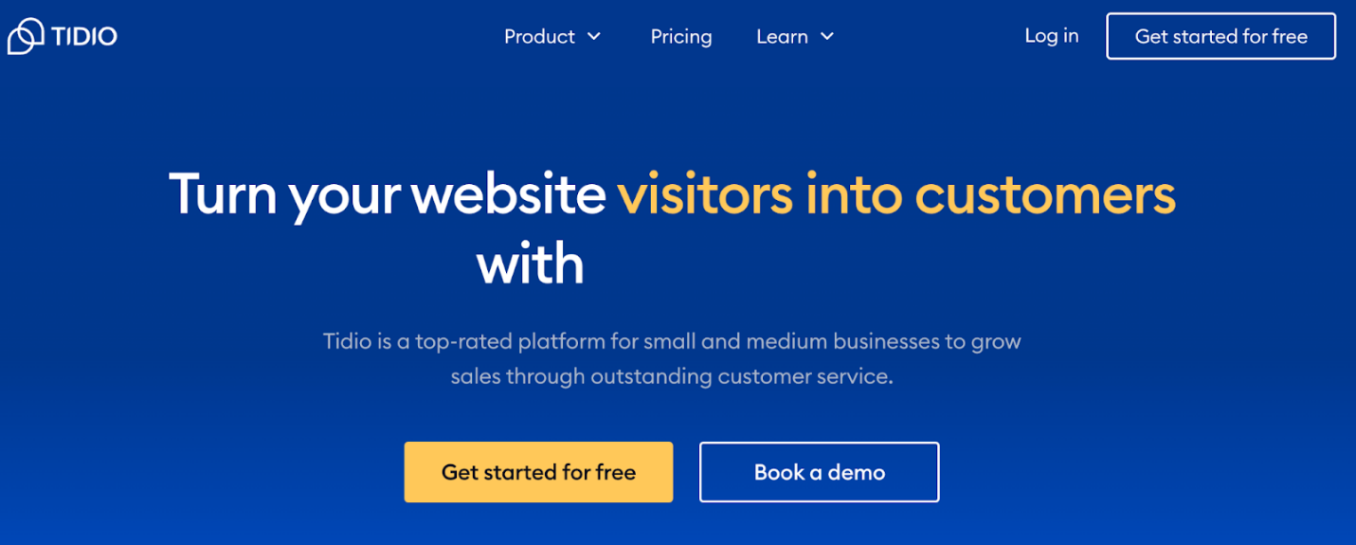
Tidio
Tidio provides customer service and focuses on increasing sales, building brand loyalty, and ensuring customer satisfaction.
Through live chat, you can respond to your customers before they decide to buy elsewhere and decrease the response time to under three minutes. With live chat, engage them in conversations, answer questions, and increase sales.
Use cases: Provide exceptional customer experience through live chat, chatbots, and multichannel communication.
Type of platform: Shopify app and SaaS plug-in
Free trial: Yes
Starting price: $15.83/month

Slide 12
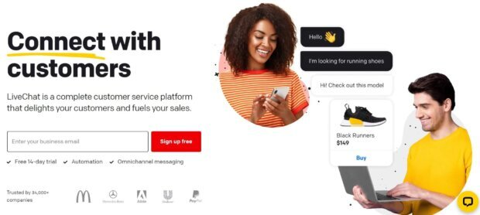
LiveChat
LiveChat is a live chat support software on the market that can help you improve customer satisfaction, conversion rate, and revenue.
Key Features:
Saved templates for repeated questions
File sharing
Inactivity messages
Evaluation surveys for collection feedback
Best Used For:
Improving customer satisfaction and engagement
Reducing cart abandonment
Increasing conversion rate and revenue
Pricing: Pricing starts from $20 per month.
Available On: Shopify App Store

Slide 13
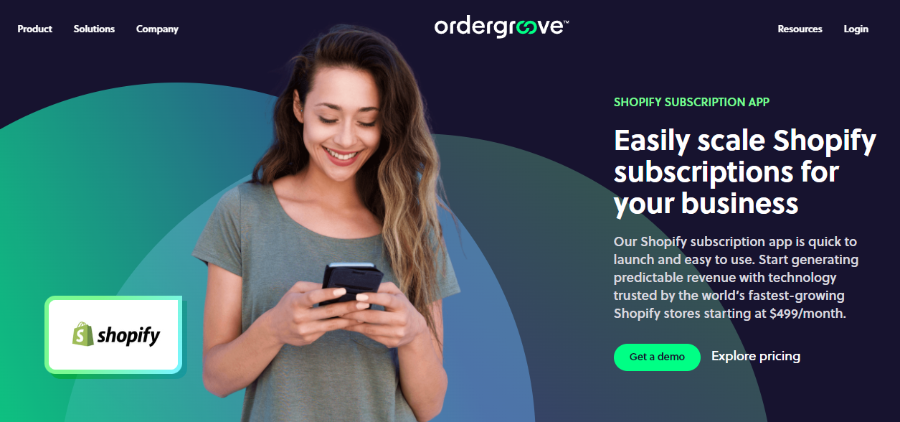
OrderGroove
Ordergroove's Shopify Subscription App is a game-changer for businesses looking to offer subscription and membership programs. Boost revenue, retention, and customer loyalty on your Shopify store.
Setting up and managing subscription programs on Shopify is a breeze with Ordergroove's user-friendly interface. Businesses can personalize their offerings based on customer preferences, and seamless integration with Shopify ensures smooth operations and high customer satisfaction.
Use cases: Sell products on a recurring basis (subscriptions), customer loyalty, membership programs
‍Type of platform: Standalone SaaS that integrates with Shopify
‍Free trial: No
‍Starting price: $499/month

Slide 14
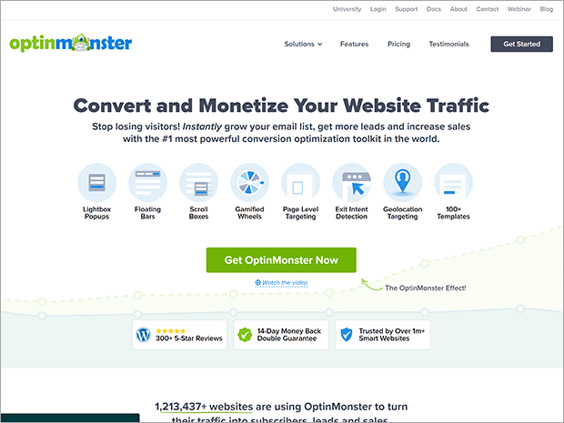
OptinMonster
OptinMonster, offers growing your email list, boosting your sales, and recovering potential customers.
Key Features:
Drag and drop campaign builder
Lots of design blocks to add videos, countdown timers, images, and more
Varied campaign types such as popup, fullscreen, floating bar, slide-in, discount wheel, inline, and content locker
50+ premade templates and playbooks
Precise targeting and triggering rules
Usable across platforms like Shopify, WooCommerce, Big Commerce, and more
Live customer support and extensive documentation
Pricing: Starts at $9/month for up to 2,500 campaign impressions.

Slide 15
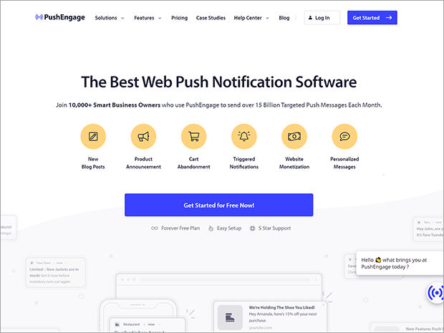
PushEngage
PushEngage is a push notification Shopify app you can use to send custom notifications to your visitors. This lets you recover abandoned carts, re-engage with users when they’re on the site, and ultimately drive more sales.
Key Features:
Customizable optin display rules
Flexible push notification design options
Automated abandoned cart messages
Audience segmentation
Easy setup with no coding required
Best Used For:
Attracting traffic
Reengaging visitors on site
Recovering abandoned carts
Pricing: PushEngage has a free plan for up to 200 subscribers and 30 campaigns to help you get started. The pricing plans start at $9/month for up to 100K subscribers.

Slide 16
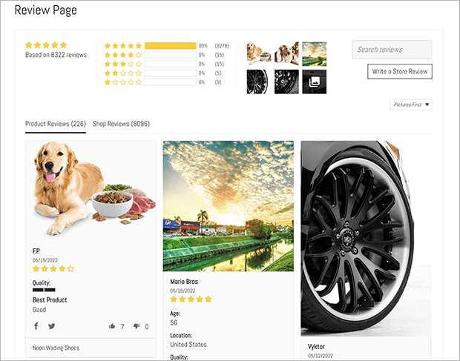
Judge.me
Judge.me - collecting and displaying customer reviews automatically.
Key Features:
Text, photos, and video reviews
SEO (search engine optimization) rich snippets
Social sharing of reviews
Best Used For:
Displaying social proof
Gathering customer feedback
Improving SEO
Pricing: Free plan available. Paid plan is $15/month and includes advanced features like coupons, product groups, and Google Shopping integration.
Available On: Shopify App Store

Slide 17
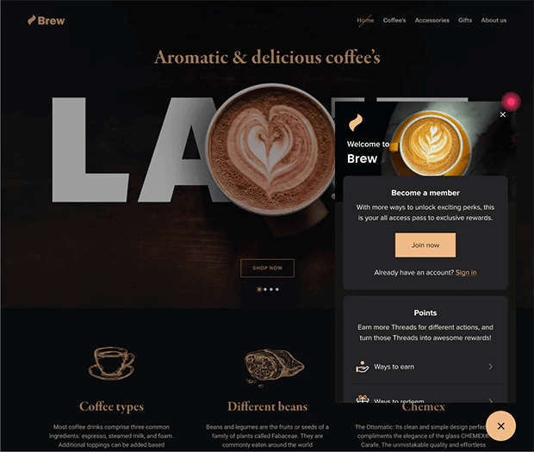
Smile: Loyalty & Rewards
Smile: Loyalty & Rewards for boosting sales from your existing customer base through points and rewards.
Key Features:
Rewards, referral, and VIP program management
Customizable widget and rewards panel
On site nudges to encourage customer engagement
Best Used For:
Growing customer loyalty
Generating referrals
Increasing lifetime value (LTV)
Pricing: Free plan available, paid plans start at $49/month and include advanced branding, unlimited orders, and more

Slide 18
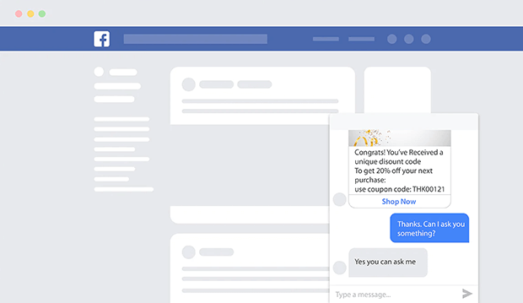
Abandoned Cart Messenger Chat
Abandoned Cart Messenger Chat is a 100% free Shopify app, allowing you to provide customer support and recover abandoned carts through Facebook Messenger.
Key Features:
Welcome and abandoned cart recovery campaigns
1-click subscription option
Discount code and messenger chat widgets
Best Used For:
Addressing customer concerns before purchase
Recovering abandoned carts
Pricing: Free
Available On: Shopify App Store

Slide 19
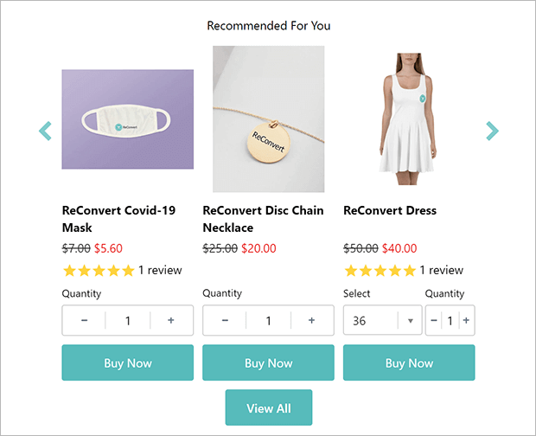
ReConvert Upsell & Cross-Sell
ReConvert lets you create one-click upsell and other offers that appear on the checkout and thank-you pages.
Key Features:
Advanced segmentation
Intuitive editor and offers and thank-you pages
AI-powered product recommendations and discount distributors
Best Used For:
Boosting average order value (AOV)
Recommending products
Collecting customer feedback
Pricing: Free plan available with 49 store orders per month, paid plans start at $7.99/month
Available On: Shopify App Store

Slide 20
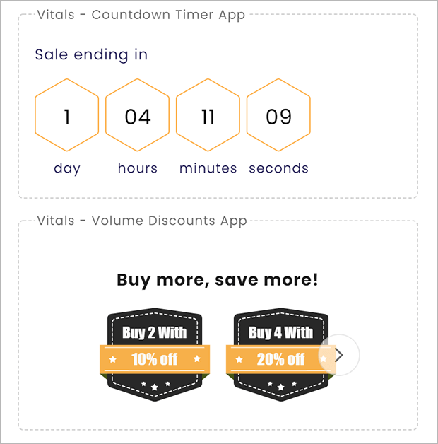
Vitals All-in-One Marketing
Vitals All-in-One Marketing This Shopify app lets you import and collect product reviews, create upsell and cross-sell campaigns, provide live customer support chat, reduce abandoned carts, improve SEO, and more.
Key Features:
Over 40 apps in one suite
Future updates and improvements included in your subscription
Speedy support team
Best Used For:
Improving user experience
Increasing order value
Showing social proof
Pricing: $29.99/month with 30-day free trial
Available On: Shopify App Store

Slide 21
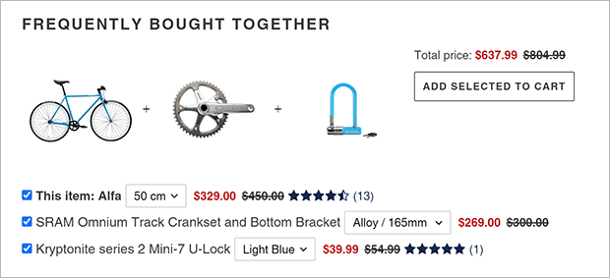
Frequently Bought Together
Frequently Bought Together brings Amazon-like related product recommendations to your Shopify store.
Key Features:
Fully customizable user interface
Multiple recommendation algorithms
Bundle discount upsells
Best Used For:
Upselling
Recommending products
Pricing: Free plan available for new businesses, paid plan starts at $9.99/month
Available On: Shopify App Store

Slide 22
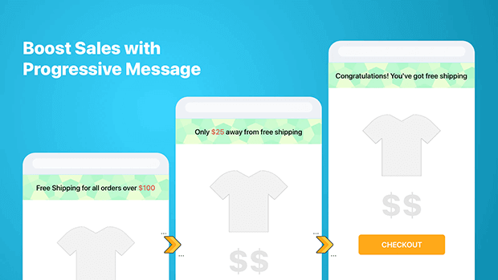
Free Gifts BOGO
Free Gifts BOGO helps you create a wide variety of gift promotions for your Shopify store.
You can increase order value by offering free gifts with purchase, discounts on cart totals, buy 1 get 1, and more. The free gifts can be added automatically or customers can choose from several offers.
Key Features:
Many offer types and customization options
Customizable gift icons
Prioritized gift offers
Best Used For:
Increasing average order value
Building customer loyalty
Pricing: Plans start at $29.99/month
Available On: Shopify App Store

Slide 23
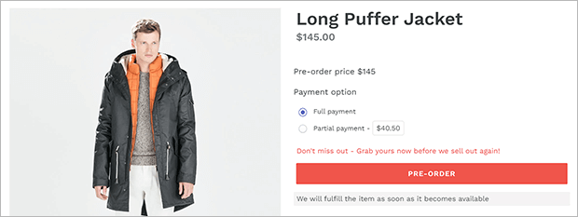
PreOrder Globo & Back in Stock
Globo PreOrder can increase your sales by offering preorders on new or out of stock products, and showing restock alerts. Customers who might otherwise leave disappointed will instead be able to preorder or get reminders to buy when the product or variant they want is back in stock.
Key Features:
Manual and scheduled preorder options
Partial payments and discounts on preorder
Customizable preorder buttons and email notifications
Best Used For:
Improving customer experience
Boosting conversion rates
Pricing: Free plan available for up to 5 products, paid plan starts at $9.90/month
Available On: Shopify App Store

Slide 24
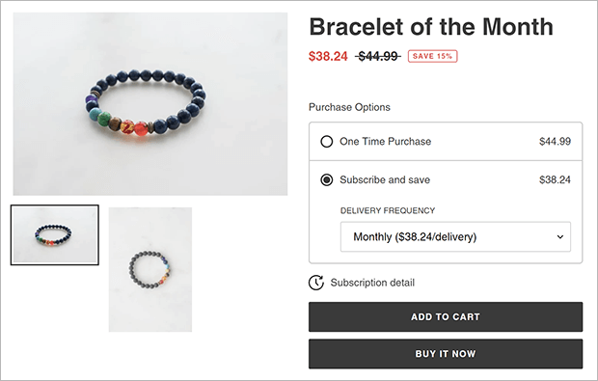
Appstle Subscriptions & Loyalty
Appstle Subscriptions is a subscription app for Shopify that lets you offer products and services to your customers on a repeating basis.
Key Features:
Unified shopping cart for one-time and subscription purchases
Tiered discounts on subscriptions
Self-managed customer portal
Best Used For:
Increasing lifetime value
Building customer loyalty
Pricing: Free plan available for up to $500 in monthly subscription sales, paid plans start at $10/month
Available On: Shopify App Store

Slide 25
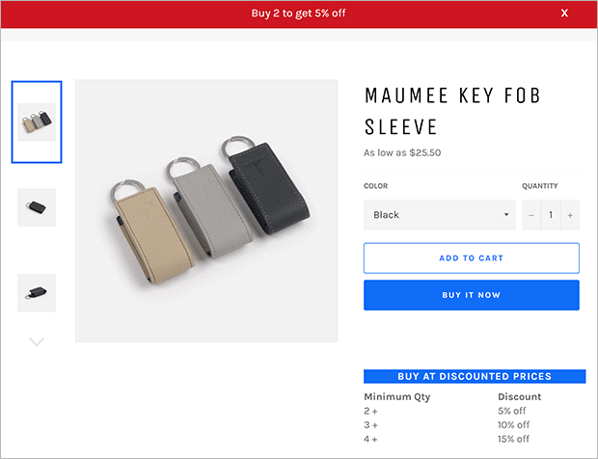
Volume & Discounted Pricing
Volume & Discounted Pricing makes it incredibly easy to offer tiered pricing and volume-based discounts. Customers are encouraged to
Key Features:
Custom pricing and discounts
Discount notification bar
Easy-to-use dashboard
Best Used For:
Increasing order value
Nurturing customer loyalty
Pricing: Starts at $7.99/month with a 7-day free trial
Available On: Shopify App Store

Slide 26
Do you have any questions?

