Slide 1
Growth Marketing Insights
& best practices for International Growth

Slide 2
by
MARYAM GOLABGIR
As a Growth marketing expert, I use data-driven strategies and tactics to achieve sustainable business growth. I provide input and guidance on various aspects of marketing, including customer acquisition, retention, and revenue generation.
My expertise includes:
Identifying and targeting the right audience
Creating compelling messaging and content
Optimizing conversion rates
Implementing and analyzing marketing campaigns
Leveraging data and analytics to make informed decisions
Staying up-to-date with the latest marketing trends and technologies
I have 18 years of digital marketing expertise in Telecommunication, E-Commerce, IPTV, A.I. Development, Broadband, renewable energy and Financial industries.
After spending ten years leading marketing teams for various fortune 500 companies, I decided to start Digital Marketing Experts. This marketing agency caters to small to medium size businesses in the Ontario, Calgary, and Vancouver. As a female entrepreneur, I have gained a unique perspective on the lives of female business owners. I understand the struggle and have learned how to design, execute and measure marketing strategies and customized campaigns for each business.
I believe it is essential to create a sustainable digital marketing strategy which will require a sharp vision and many metrics to accompany digital plans. Our digital expertise is in Social Media Marketing strategies, Website Development, Search Engine Marketing and Optimization, Online Advertising and Video / Mobile Marketing. For more information about our business, you can visit www.digitalmarketingexperts.ca or my LinkedIn profile https://www.linkedin.com/in/maryamgolabgir

Slide 3
Build Your Growth Marketing Strategy Traditionally, marketing focuses on top-of-funnel activities that attract potential customers and deliver them to sales teams. Growth marketing integrates the entire pipeline.
Notes:
Traditionally, marketing focuses on top-of-funnel activities that attract potential customers and deliver them to sales teams. Growth marketing integrates the entire pipeline. When implemented effectively, this approach leverages every opportunity to acquire, convert, and retain the most customers in the shortest period — ultimately driving rapid growth.
Growth marketing often re-envisions the role of marketing departments to achieve these goals. Rather than generating leads, growth marketers create a qualified pipeline that makes revenue the overarching goal. This approach aligns teams with sales departments philosophically and often contributes to cost reduction across the entire pipeline.
Top-of-funnel marketing may be enough if your marketing and sales teams are already aligned. However, if KPIs don’t translate into sales or decrease churn, growth marketing is an excellent solution.
It’s particularly effective among B2B companies in the tech sector, where a holistic approach to performance drives revenue. Forthcoming research from 6sense shows that the best B2B marketers are:
28% more likely to list revenue as their top KPI
17& more likely to take responsibility for upsells
21% more likely to take responsibility for customer retention

Slide 4
How to create a successful global marketing strategy?
A global marketing strategy streamlines your company’s brand vision to present to your target markets. This will serve as the basis for determining the right angle to promote your brand in foreign markets, so your social media, events, brand messages, and even PR will all play a pivotal role here.
Many businesses use one of the four main international business strategies to begin expanding globally:
International: Where a company has an overarching marketing plan, so they don’t have any intention of changing the way they sell their products internationally.
Multi-domestic: Here, the company focuses its local marketing strategy on ensuring its product conforms to the local standards and regulations in each of its target markets.
Global: Here, the company is mainly concerned with decreasing costs while improving efficiency in promoting their products, ignoring responsiveness to local preferences.
Transnational: This type of global marketing strategy strikes a balance between a multi-domestic strategy and a global strategy.

Slide 5
Research Your Market and Ideal Customer(s)
The first step in expanding internationally is researching your market and ideal customers in each foreign country. For this, you need to:
Identify your target market: Identify your target market, competitors, and ideal customers.
Get as specific as possible and zero in on the details: geographical scope, demographics, purchasing power.
Gather secondary data: Collect data from existing market reports, industry publications, and government research.
Do your own research: Conduct primary research using surveys and interviews to gather first-hand information from potential customers and partners and discover who your customer base really is.
Analyze the data: Identify important patterns, trends, risks, and opportunities.
Define your goals and strategy: Use the insights to inform your goals and marketing strategy, including product development, pricing, distribution, and promotion channels.

Slide 6
Identify Key Pain Points & Opportunities
Once you have an idea of who your customer base is in each market, work on identifying the key pain points they’re struggling with and how you can help.
Here are some questions that might help you with this:
What are the existing solutions that your new customers are currently using?
How does your product or service compare to them?
What are the gaps in the market that your product or service can fill?
What are the unique cultural, economic, and social factors that may impact your target market’s pain points, needs, and expectations?
How can you position your product or service (with the help of social media, organic reach, or Google Ads, for example) to provide relevant solutions at the right time?
Is there a particular way all local competitors are addressing the target audience’s pain points? Are there alternative approaches you could experiment with?

Slide 7
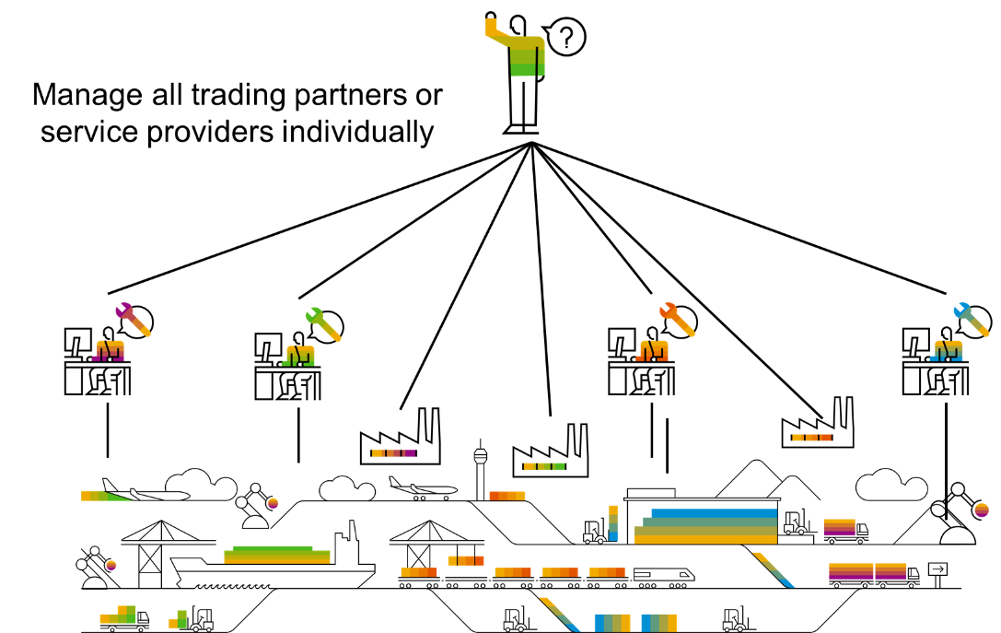
Build a Network of Partners and Suppliers
A strong network of partners and suppliers is the backbone of any successful global business. Your local contacts will have invaluable expertise and knowledge of the market; through networking, you’ll be able to gather important insights on how to best conquer a new market. Building a global team and network can help ease your growth strategy with insights you can’t always get from your home country alone.

Slide 8
When you think of content marketing, think globally: Plan how to localize your website content to reach your target audience is an essential part of the expansion process and language should always address cultural differences.
Consider language targeting for ads: Use local online ads that are displayed only to users that speak a specific language
Leverage the power of AI: Plan to use multilingual chatbots to assist local customers in their own language in different parts of the world
Consider social media content: Think about social media content and decide how you’ll adapt it to different markets; this might require creating new profiles for different markets or using social media ads strategically. And don’t forget to consider different time zones and that will impact your posting strategy.
Create a Global Marketing Strategy

Slide 9
Build Your Local Presence
Once you define your strategy, it’s time to start building your local presence.
This might mean creating a physical presence or a local business entity, or it might simply mean creating an online presence for each local market, i.e. a localized version of your website. Translating and localizing the content of your website is an essential part of a global expansion and in particular an area of the process the marketing team is usually responsible for. Traditionally considered a time-consuming process, website translation can be completely automated with the right website translation software.

Slide 10
Launch Localized Marketing Campaigns
With the launch of your product, you also need to launch localized marketing campaigns to capture the attention of your target country and ensure business growth. For this, you might use:
Local Google Ads
Local social media ads and content
Localized website content
Website content produced specifically for your new target audience
Aim to build coherent campaigns on 2-3 key marketing channels rather than trying to be present everywhere (more on that later).

Slide 11
Take Care of International SEO
To capture local traffic, you’ll also need to handle technical aspects on your site that contribute to your international SEO. This is an extension of localizing your content and ensures you’re actually discoverable in different countries and impacts the global growth of your website and company. You need to:
Translate all website metadata (meta titles, meta descriptions)
Use language-specific URLs
Implement hreflang tags correctly

Slide 12
Analyze Results and Look for Improvement Opportunities
No market strategy is complete without the last step: Analyzing your results.
Performance marketing is a strategy that increasingly more marketers are adopting, as it enables you to see what actually works and how to optimize your marketing efforts to boost conversions.
Collecting key data and looking at it methodically takes the anxiety and guesswork out of marketing, so make sure you have the right systems in place to track results, such as GA4, a CRM platform, the right campaign management tools, and more.
36

Slide 13
A qualified, well-optimized pipeline.
Understanding how this pipeline converts your audience into qualified leads and customers is the most vital ingredient of any successful strategy. The first step is to build a growth marketing strategy.
There’s a lot that goes into it, but one of the highest return activities is a pipeline audit to determine where customers are churning from your pipeline. While some loss is normal, sudden or significant drops can indicate a problem with your messaging or the strategy itself.

Slide 14
Begin with Marketing Activities That Drive Awareness and Acquire Users
Anyone visiting your website, engaging (but not following) your brand on social media, and other top-of-funnel activities.
Analyze their performance by determining how many potential leads are directed further along the pipeline.
Take a Closer Look at Mid-Tier Leads
These are individuals who engage with your brand — perhaps they click links on your website, follow your social media profiles, or otherwise find value in your content.
Pay attention to how many top-of-funnel leads arrive at this stage in the pipeline.
Examine the Revenue Generation Stage of Your Pipeline
These are customers who fully convert to closed-won.
Go beyond tracking revenue and customer numbers by comparing these KPIs with performance earlier in the pipeline.
This stage is also a valuable source for retargeting customers for future purchases.

Slide 15
Buyer Personas
One of the most crucial aspects of growth marketing is understanding your customer needs.
More specifically, Grasp what messaging will resonate with them.
Segment customers from your sales and marketing data by demographics like industry, geographic location, and job title.
Determine the specific needs your product or service will address by audience.
Create profiles for individuals who reflect each of the steps mentioned above.
Leverage the Right Growth Marketing Techniques

Slide 16
Every product’s onboarding process will be a little different. However, here are some best practices to keep in mind:
Set a goal of helping customers engage with your product at least twice in the first week. Highlight your value immediately to impress customers and give them a reason to continue using it.
Onboarding Optimization
Reducing churn is one of the most useful ways to drive growth; after all, if you can’t retain your customers, no amount of acquisition will bring long-term value.
Retention strategies vary by product and service, but one of the best churn solutions is to optimize your onboarding process. If customers can learn how to use your service quickly or understand it intuitively, they will embrace its value more fully.
Keep lines of communication open with your customers. Some options may include email updates, in-app notifications, or accessible support options. The more personalized these communications can be, the better.
Introduce one feature at a time. Give customers time to experiment before moving on. This approach helps them understand how elements fit together without becoming overwhelmed by the product as a whole.

Slide 17
A/B Testing
Growth marketing demands a constant re-evaluation of brand content to ensure a given strategy reflects its target market. One of the best ways to accomplish this is with A/B testing — running two variants of the same messaging to see which performs better.
Once you have statistically significant results favouring one of the variants, apply it to a campaign on the whole.
A/B testing is a common technique for ad creative. Brands can test any marketing asset, including:
• Web pages
• Emails
• CTAs
• Article headlines
• Product packaging
• Social media posts
• Promotional images
To run an A/B test, create two versions of the same content and distribute them to a selection of customers through the appropriate channels. Be sure to monitor key performance indicators, from ad engagement to conversions.

Slide 18
Most Common Marketing Mistakes When Expanding to New Markets & How to Avoid Them

Slide 19
Poor Market Fit
13
Poor market fit is the first danger that lies ahead of you.
If you fail to meet the needs or preferences of the target market with the product or service you’re offering, this might lead to a poor sales performance. Or, otherwise said, you’d have wasted the resources you invested into your expansion.
Before you launch your product or service, research your market thoroughly by collecting and analyzing data on each target market’s needs, preferences, behaviors, and trends.
How to Avoid a Poor Market Fit?

Slide 20
Poorly Translated Website or Marketing Materials
One of the cornerstones of multilingual marketing is the correct and culturally appropriate translation of your website content, ads, and other marketing materials.
If you don’t translate your website or other marketing assets into local languages or do a poor job at it, you risk harming your brand image, looking amateurish, and even offending and alienating potential customers.
53%
Quality
36%
Cost
32%
If I trust the brand
How to Avoid a Bad Translation
31%
Good reputation
31%
Positive customer reviews
31%
Special offers/ discounts
Thankfully, there are many tools and website translation plugins that can help you with the translation of your website.
Choose the right translation method (machine or human translation, or, ideally, a mix between the two)
Use the right translation software tool
Proofread the translation of your website
29%
If it fits with my personality/style
27%
Good customer service
23%
If I'm familiar with the brand
16%
If I align with the company/brand values
15%
Brand support/ action for climate change
20%
If it's convenient to find/buy

Slide 21
Not Taking Care of International SEO
How to Build a Solid Multilingual SEO Strategy
If you just translate your website but fail to take care of your international SEO, it might simply not be correctly indexed for each language, which could have a dramatic impact on your visibility in search results.
Multilingual SEO uses the same key principles as “standard” SEO in your home market, i.e. you need to analyze your target location, keywords, search volumes, and always strive to provide content that is useful, well-structured, and satisfies the users’ intent.

Slide 22
Trying to Be Present Everywhere
Concentrate on 2 to 3 marketing channels and work on growing these. Overall, you have the choice between:
Your blog (driving organic traffic)
Your newsletter (growing an international audience list)
Different social media channels (pick one or two at most, especially in the beginning)
The best channels to choose depend on your target audience and where your ideal customers spend their time, the networks and social media channels that are the most popular in your target market, and also on your experience with each channel.
How to Avoid Spreading Your Marketing Strategy Too Thin
Launching instantly in multiple markets is a risky endeavour, but the same can also be said for being present on too many marketing channels. This can dilute your efforts and not build a recognizable presence anywhere.

Slide 23
Not Tracking Results (Or Not Using the Right Metrics)
Measuring marketing performance might be notoriously difficult but you need to do it if you want to make sure you’re investing in the right marketing initiatives. If you don’t track results, how do you know if your success is a fluke or the result of the right strategy? And most importantly, how do you replicate it across markets?
Define KPIs and make sure you have the right systems in place to track them. Those include:
Google Analytics and Google Search Console
A customer relationship management (CRM) platform like Salesforce, HubSpot, Zendesk, etc.; most CRM systems double as campaign management tools
Email marketing tools like MailChimp, ActiveCampaign, Klavyo
Social media and search engine ads’ tracking systems
How to Make Sure You’re Tracking Results the Right Way

Slide 24
Do you have any questions?

