Slide 1
Amazon & Shopify Integration & Marketing Strategies

Slide 2
by
MARYAM GOLABGIR
The Shopify x Amazon integration lets you sell your products on both Amazon and Shopify. This gives you access to a wider audience and can help you boost your sales.
I have 18 years of digital marketing expertise in Telecommunication, E-Commerce, IPTV, A.I. Development, Broadband, renewable energy and Financial industries. After spending ten years leading marketing teams for various fortune 500 companies, I decided to start Digital Marketing Experts. This marketing agency caters to small to medium size businesses in the Greater Toronto area. As a female entrepreneur, I have gained a unique perspective on the lives of female business owners. I understand the struggle and have learned how to design, execute and measure marketing strategies and customized campaigns for each business.
I believe it is essential to create a sustainable digital marketing strategy which will require a sharp vision and many metrics to accompany digital plans. Our digital expertise is in Social Media Marketing strategies, Website Development, Search Engine Marketing and Optimization, Online Advertising and Video / Mobile Marketing. For more information about our business, you can visit www.digitalmarketingexperts.ca or my LinkedIn profile https://www.linkedin.com/in/maryamgolabgir

Slide 3
In August 2023, Amazon and Shopify announced an exciting partnership that offers significant benefits to both parties and merchants!
This collaboration allows Shopify merchants to include Amazon's popular "Buy with Prime" feature in their Shopify stores.
This means that Shopify merchants who use Amazon's efficient delivery network can offer the convenience of fast and free Prime delivery to their customers, even when they make purchases through the Shopify platform.

Slide 4
How Can Sellers Benefit From Amazon Shopify Integration in 2023?

Slide 5
Expanded Reach
Amazon is the world's largest online marketplace, with over 300 million active customers. By selling your products on Amazon, you can reach a much wider audience than you could on your own Shopify store.
Streamlined Operations and Time Savings
With Amazon Shopify integration, you can streamline various aspects of your eCommerce operations. This includes inventory management, order fulfillment, and product listings.
By automating these processes, you'll free up valuable time to concentrate on value-added business tasks like product development, marketing strategies, and enhancing the visual appeal of your online store.

Slide 6
Boosted Sales With Social Proof
The Amazon x Shopify integration allows you to leverage the power of social proof to boost your conversions. Customer reviews play a pivotal role in building trust with potential buyers. With this integration, you can effortlessly import reviews from Amazon to your Shopify store.
Enhancing Aesthetics and Branding
The Shopify x Amazon integration helps you maintain a consistent brand identity across both platforms. You can customize your product listings and storefront design to align with your unique branding, ensuring a visually pleasing and cohesive customer experience.

Slide 7
How the Shopify Amazon Integration is advantageous for your business growth?

Slide 9
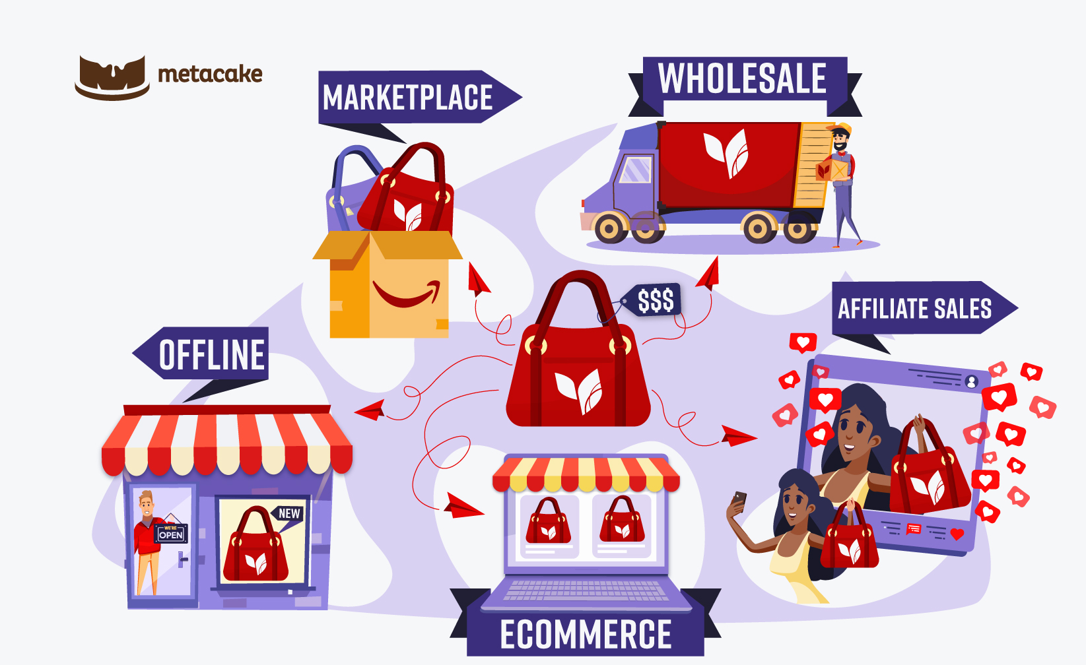
Diversifying Your Sales Channels
One of the primary advantages of the Shopify Amazon integration is the ability to diversify your sales channels.
Connecting your Shopify store to Amazon's vast marketplace gives you access to millions of potential customers who browse and shop on Amazon daily.
By diversifying your sales channels, you can reduce your risk of losing sales if one channel is down. When you give customers multiple options for how to buy your products, you can improve their shopping experience and realize improved customer satisfaction and loyalty.

Slide 10
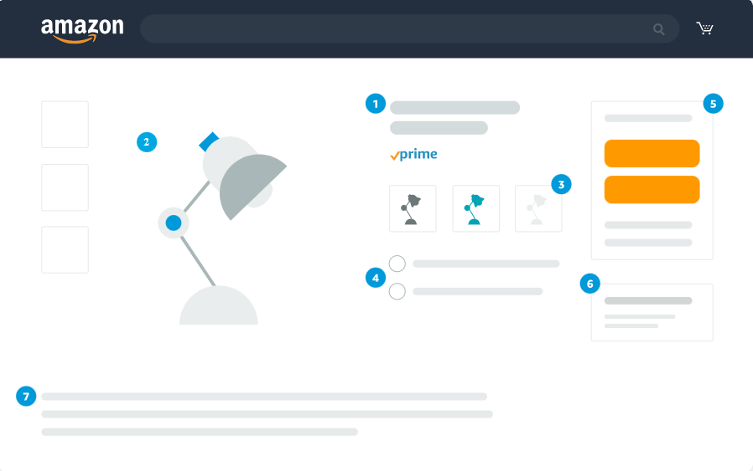
Simplifying Inventory Management
Efficient inventory management is crucial for any eCommerce business, especially for entrepreneurs like you, who appreciate messaging that positions tools as productivity enhancers.
With Shopify Amazon integration, When a product is sold on either your Shopify store or Amazon, the inventory levels are automatically updated across both platforms.

Slide 11
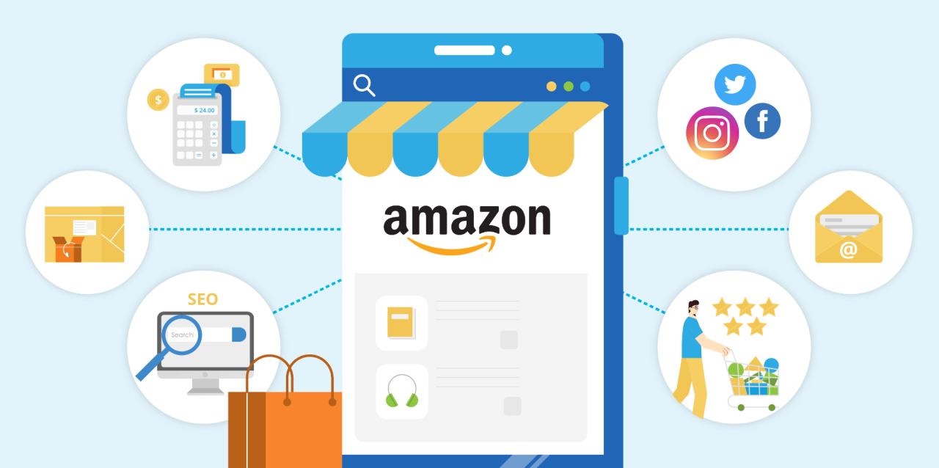
Leveraging Amazon's Fulfilment Network
Amazon's Fulfilment by Amazon (FBA) service is a powerful asset for sellers seeking efficient order fulfilment. By enrolling in FBA, you can store your products in Amazon's fulfilment centres. Amazon then handles storage, packing, and shipping of orders to your customers.

Slide 12
Seamless Product Listing and Syncing
Maintaining product listings and ensuring they are consistent across multiple platforms can be daunting. However, with the Shopify Amazon integration, this process becomes seamless.
You can list products on Shopify and sync them to your Amazon Seller Central account, ensuring consistent product details, pricing, and availability.

Slide 13
What is the Best App to Integrate Shopify and Amazon?

Slide 14
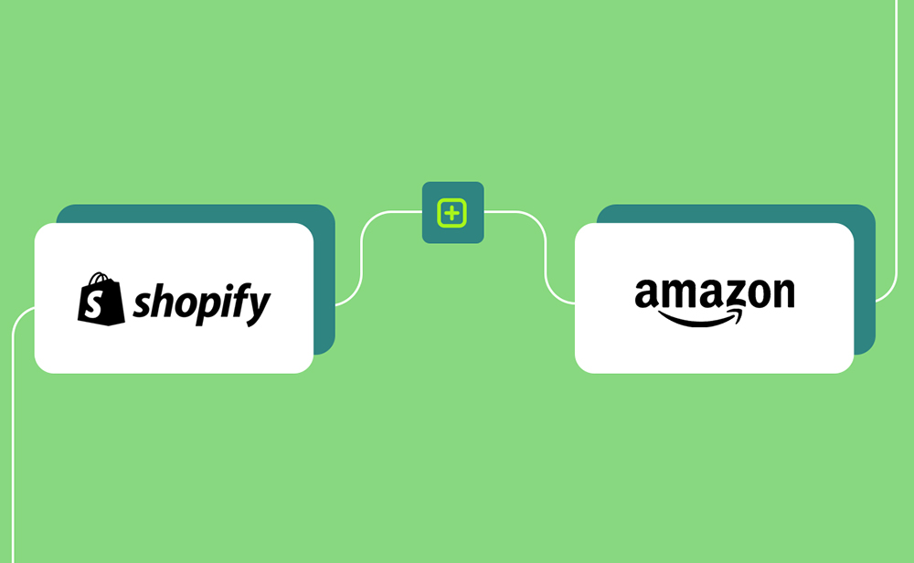
Introducing the Power of the Shopify Amazon Sales Channel
The Shopify Amazon Sales Channel by Cedcommerce is a robust and highly effective tool for seamlessly integrating your Shopify store with Amazon that comes with benefits like:
Effortless Product Listings: Easily list your Shopify products on Amazon, ensuring consistency in product details, pricing, and availability.
Inventory Sync: Automate inventory management, updating stock levels on both platforms in real-time.
Order Management: Centralize order processing, allowing you to fulfill Amazon orders directly from your Shopify dashboard.
Fulfillment by Amazon (FBA): Leverage Amazon's FBA service, the integration ensures smooth management of your FBA inventory.
Customer Support: Shopify offers excellent customer support, ensuring you have the assistance you need whenever you encounter any issues or have questions.

Slide 15
How Do I Add My Product from Shopify to Amazon?

Slide 16
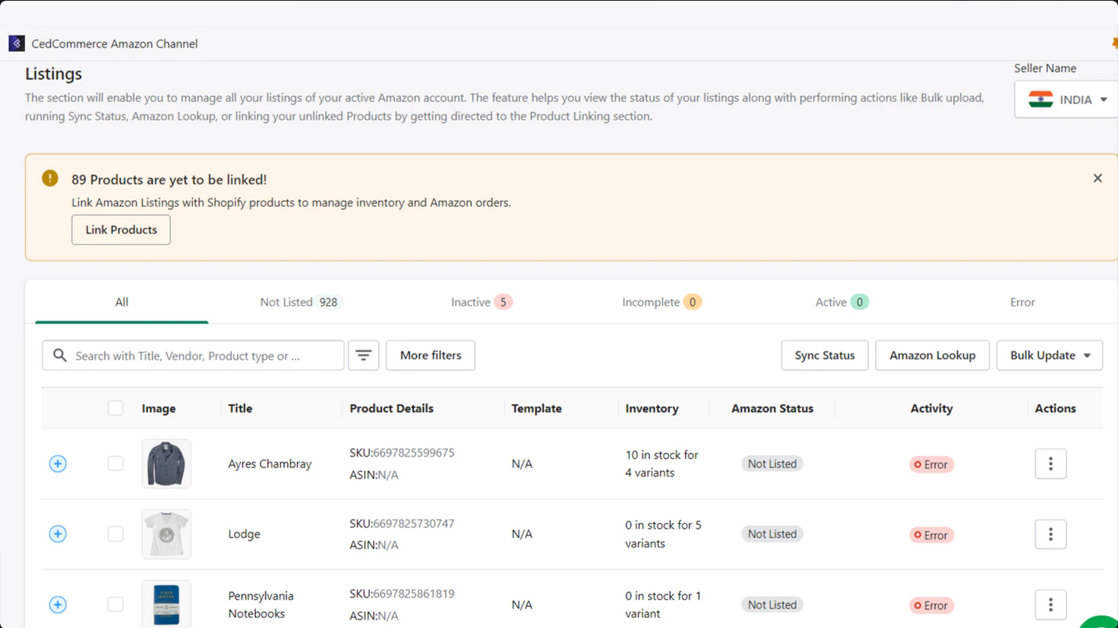
Step 1: Install the Shopify Amazon Sales Channel App.
Start by installing the Shopify Amazon Sales Channel app from the Shopify App Store if you haven't already.
Step 2: Connect Your Amazon Seller Account
Connect your Amazon Seller Account to Shopify by providing the necessary credentials.
Step 3: Configure Your Product Listings
Select the products you want to list on Amazon. You can customize product details, including pricing, descriptions, and images, to ensure they align with your Amazon strategy.
Step 4: Publish Your Products
Once your product listings are configured to your satisfaction, you can publish them to Amazon directly from your Shopify dashboard.

Slide 17
How Can I Sync My Reviews from Amazon to Shopify?

Slide 18
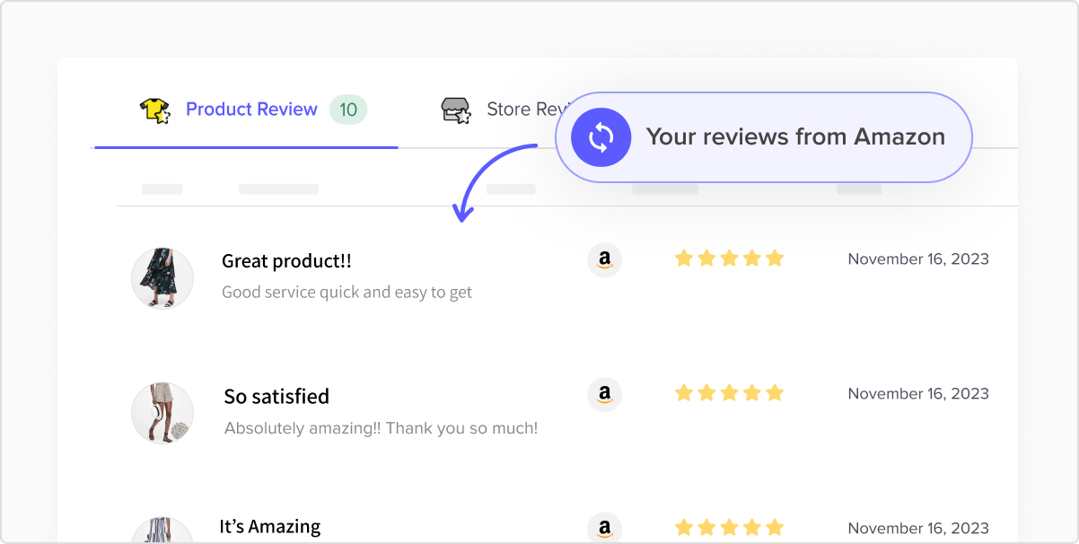
Step 1: Install the Fera App
Begin by installing the Fera app from the Shopify App Store. Fera specializes in collecting high-quality reviews and integrating them seamlessly into your eCommerce store.
Step 2: Connect Your Amazon Account
Within the Fera app, connect your Amazon Seller Account. This allows Fera to access your Amazon reviews.
Step 3: Customize Review Display
Customize how you want your Amazon reviews to appear on your Shopify store. You can choose the display format, location, and design to match your store's aesthetics.
Step 4: Sync Reviews
Fera will automatically sync your Amazon reviews to your Shopify product pages. This helps build trust and credibility among your Shopify store visitors, ultimately driving sales and customer engagement.

Slide 19
Best Practices for Amazon-Shopify Integration

Slide 20
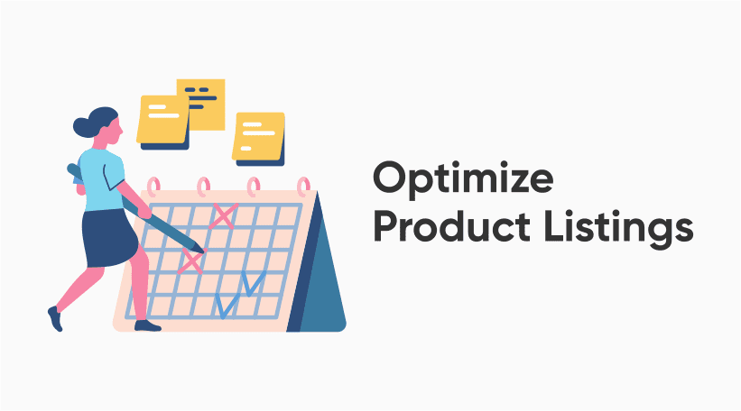
High-Quality Images: Use clear, high-resolution images that showcase your products from multiple angles. High-quality visuals can significantly impact purchasing decisions.
Engaging Titles: Craft descriptive and keyword-rich product titles that accurately represent your items. Use keywords that shoppers are likely to search for on both Amazon and Shopify.
Detailed Descriptions: Write detailed, informative product descriptions that highlight key features, benefits, and specifications. Include any unique selling points that differentiate your products.
Bullet Points: Use bullet points to create easily scannable, concise lists of product attributes and benefits. This format helps potential customers quickly grasp essential information.
Keyword Research: Conduct thorough keyword research to identify the most relevant and high-traffic keywords for your products. Incorporate these keywords naturally into your listings.
SEO Optimization: Optimize your product listings for search engines. This includes using relevant keywords in titles, descriptions, and meta tags.
Clear Pricing: Ensure that your pricing is competitive and transparent. Avoid hidden fees or unexpected costs that might deter potential buyers.

Slide 21
Pricing and Promotion Strategies
Competitive Pricing: Continuously monitor and adjust your prices to remain competitive in the market. Consider using pricing intelligence tools to stay informed about competitor pricing.
Dynamic Pricing: Utilize dynamic pricing strategies that automatically adjust your prices based on market conditions, competitor prices, and demand fluctuations.
Flash Sales and Discounts: Run time-limited promotions, flash sales, or discount events to create a sense of urgency and encourage impulse purchases.
Bundling Products: Consider bundling related products together and offering them at a discounted rate. This can increase the average order value and enhance the perceived value for customers.
Loyalty Programs: Implement loyalty programs or customer rewards to incentivize repeat purchases and foster customer loyalty.

Slide 22
Customer Service and Feedback
Prompt Communication: Respond promptly to customer inquiries and messages on both Amazon and Shopify. Timely and helpful responses build trust with customers.
Order Tracking: Provide customers with tracking information for their orders. This transparency enhances the customer experience and reduces inquiries about order status.
Handling Returns: Establish a clear and efficient returns process. Make it easy for customers to return products, and ensure that returns are processed promptly.
Feedback Management: Monitor customer feedback and reviews closely. Address any negative feedback professionally and offer solutions when issues arise. Encourage satisfied customers to leave positive reviews.
Feedback Solicitation: Encourage customers to provide feedback by sending follow-up emails or messages after their purchase. Positive reviews can boost your credibility.
Continuous Improvement: Use customer feedback to identify areas for improvement in your products, services, and processes. Implement changes as needed to enhance the customer experience.

Slide 23
What is the Difference Between Shopify Drop shipping and Amazon FBA?

Slide 24
1. Ownership of Inventory
Shopify Drop shipping: Here you don't need to hold inventory. You partner with suppliers who ship products directly to customers when orders are placed.
Amazon FBA: With FBA, you are required to stock your inventory in Amazon's fulfilment centres. Amazon takes care of storage, packing, and shipping of orders.
2. Control Over Products
Shopify Drop shipping: You have more flexibility in choosing the products you want to sell, as you're not tied to a specific inventory.
Amazon FBA: While you can choose what to sell, you need to adhere to Amazon's fulfilment requirements, and your products must meet their standards.
3. Shipping and Fulfilment
Shopify Drop shipping: You're responsible for finding reliable suppliers and managing shipping times, which can vary.
Amazon FBA: Amazon handles all aspects of order fulfilment, ensuring fast and reliable shipping for Prime members.

Slide 25
4. Branding and Customization
Shopify Drop shipping: You have more control over your branding, packaging, and customer experience.
Amazon FBA: Amazon's branding takes precedence, and you have limited control over the packaging and customer experience.
5. Fees and Costs
Shopify Drop shipping: You may have lower upfront costs as you don't need to purchase inventory, but you may face higher marketing expenses.
Amazon FBA: FBA involves storage and fulfilment fees, but it can offer cost savings in terms of shipping and customer trust.
6. Competition
Shopify Drop shipping: The model is popular, leading to intense competition in certain niches.
Amazon FBA: Competition exists on Amazon, but the platform's vast customer base can provide significant exposure.
7. Control Over Pricing
Shopify Drop shipping: You have more control over pricing strategies and profit margins.
Amazon FBA: Amazon's pricing policies can impact your pricing decisions.

Slide 26
ANY QUESTIONS?

